Slide 1
Big Data Technologies
Chapter 2
Google File System
Instructor: Suresh Pokharel

Slide 2
Motivation
Q3. Which is the most engaging social network?
Nothing is small in Google land [Scalability]
Peta-bytes of data
Millions of users
Lots of services and servers
Failures are normal [Fault tolerance]
Network connections
Hard disks
Power supplies
Monitoring and maintenance is hard [Autonomic computing]
Clusters all over the world
Thousands of queries served per second
One query reads hundreds of MB of data
One query consumes billions of CPU cycles
A distributed, fault-tolerant file system is needed!

Slide 3
Google Data Center
Scaling out on commodity hardware is cheaper than Scaling up on high-end servers
Google servers:
> 15 000 servers (2003)
~ 200 000 (2005)
~ 1 M servers (2010)
Data centers are composed of standard shipping containers with 1160 servers in each

Slide 4
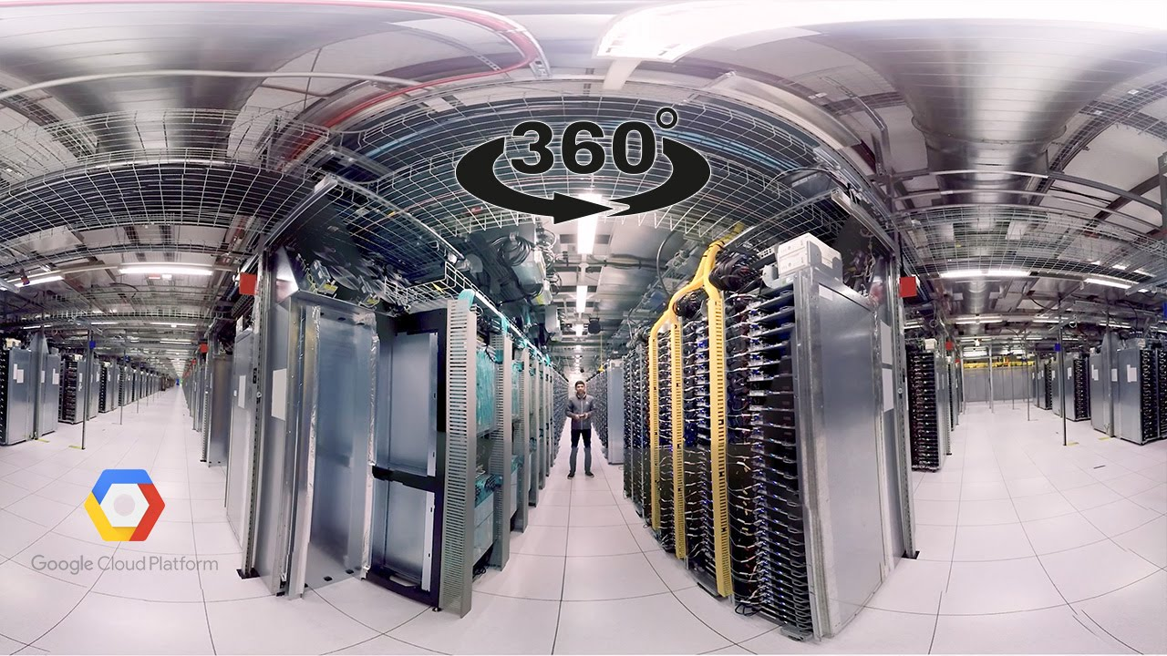
Google Data Center
Ref: https://www.youtube.com/watch?v=zDAYZU4A3w0

Slide 5
Google file system (GFS)
Google File System, a scalable distributed file system for large distributed data-intensive applications.
Google File System (GFS) to meet the rapidly growing demands of Google’s data processing needs.
GFS shares many of the same goals as other distributed file systems such as performance, scalability, reliability, and availability.
GFS provides a familiar file system interface.
Files are organized hierarchically in directories and identified by pathnames.
Support the usual operations to create, delete, open, close, read, and write files.

Slide 6
GFS
Small as well as multi-GB files are common.
Each file typically contains many application objects such as web documents.
GFS provides an atomic append operation called record append. In a traditional write, the client specifies the offset at which data is to be written.
Concurrent writes to the same region are not serializable.
GFS has snapshot and record append operations.

Slide 7
Other GFS Concepts
Component failures are the norm rather than the exception.
File System consists of hundreds or even thousands of storage machines built from inexpensive commodity parts.
Files are Huge. Multi-GB Files are common.
Each file typically contains many application objects such as web documents.
Append, Append, Append.
Most files are mutated by appending new data rather than overwriting
existing data.
Co-Designing
Co-designing applications and file system API benefits overall system by increasing flexibility.

Slide 8
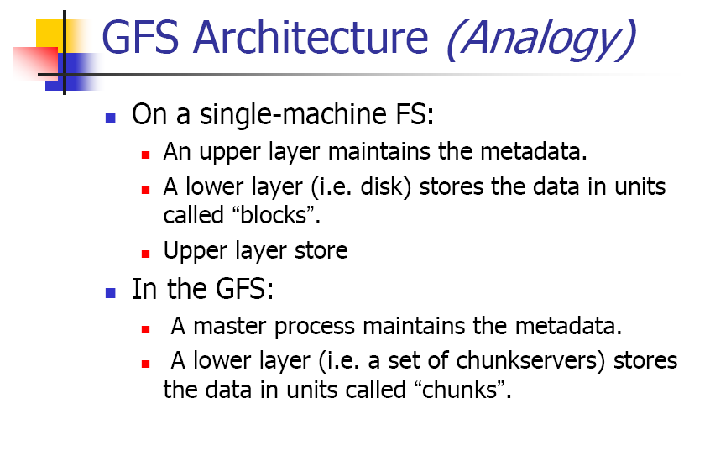
GFS Architecture

Slide 9
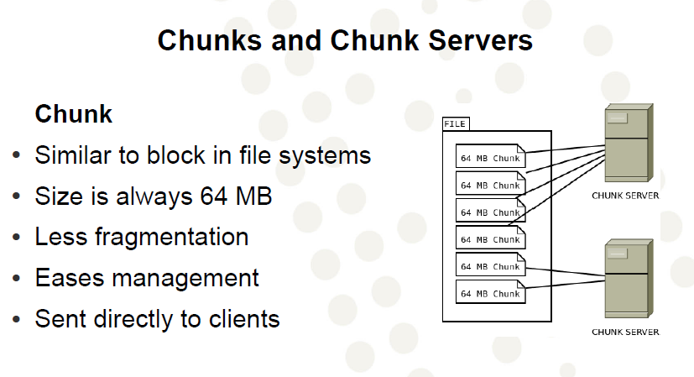
GFS Architecture
Each block contains 64KB Block size

Slide 10
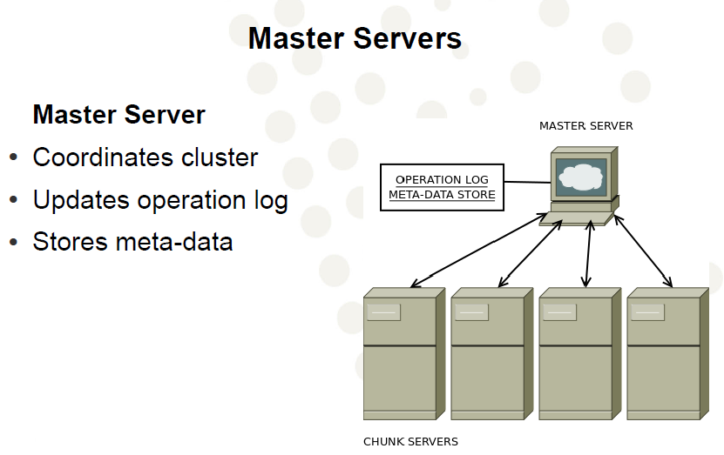
GFS Architecture

Slide 11
Master Server – Chunk Server Communication
State updates
● Is a chunk server down?
● Are there disk failures on a chunk server?
● Are any replicas corrupted?
● Which chunk replicas does a chunk server store?
Instructions
● Create new chunk
● Delete existing chunks

Slide 12
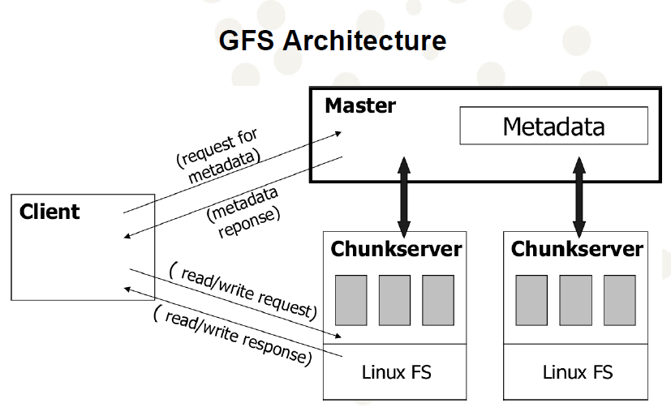
GFS Architecture

Slide 13
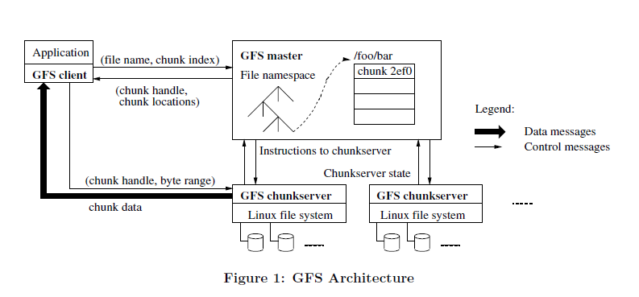
GFS Architecture

Slide 14
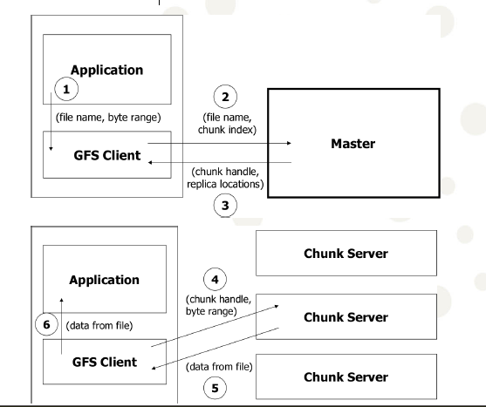
Read Operation

Slide 15
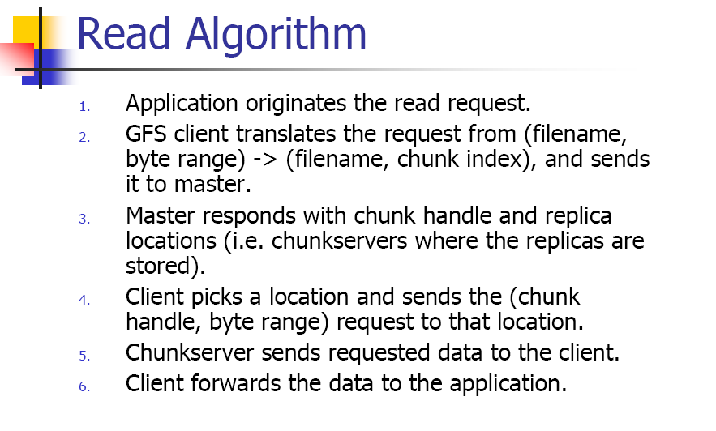

Slide 16
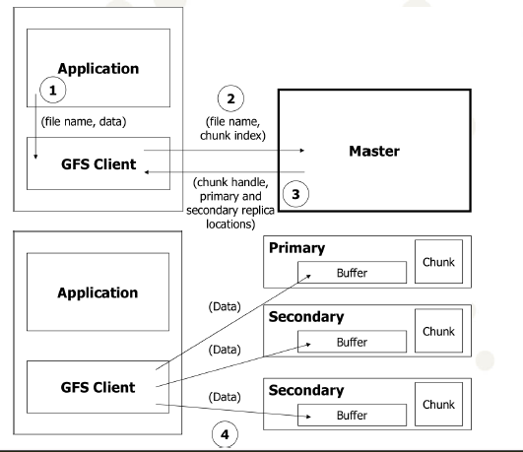
Write operation (1/2)

Slide 17
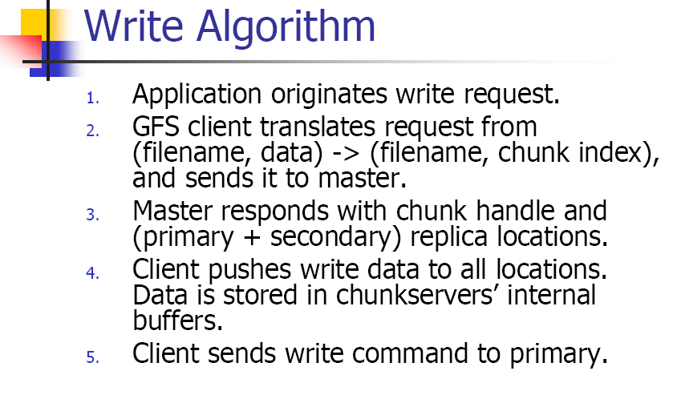

Slide 18
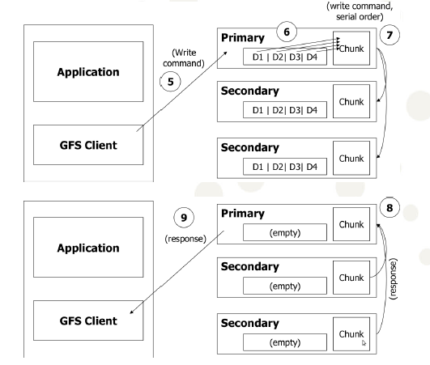
Write operation (2/2)

Slide 19
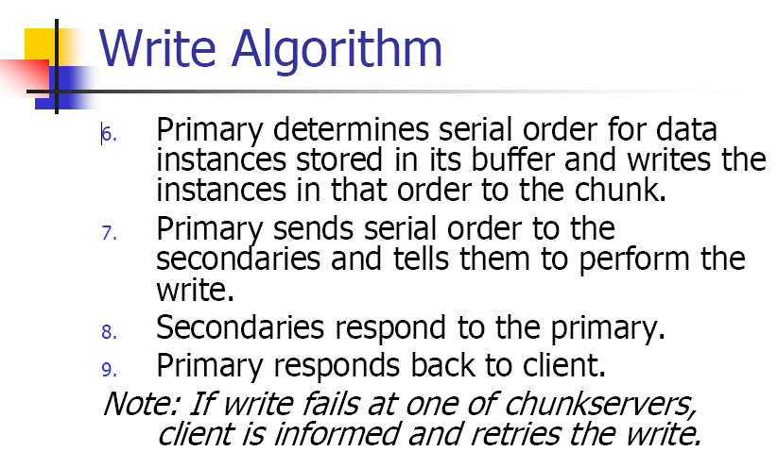

Slide 20
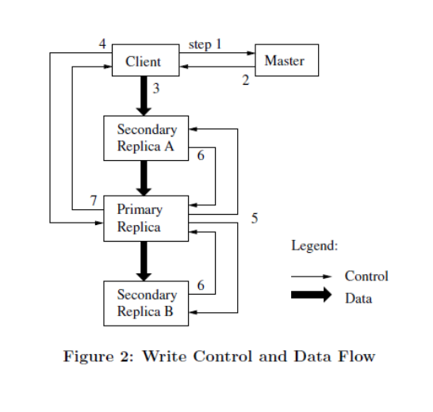
Write control and data flow

Slide 21
Append
Record append allows multiple clients to append data to the same file concurrently while guaranteeing atomicity
Algorithm
● Application originates record append request.
● GFS client translates request and sends it to master.
● Master responds with chunk handle and (primary + secondary) replica locations.
● Client pushes write data to all locations.
● Primary check if record fits in specified chunk.
● If record does not fit, then the primary:
● Pads the chunk.
● Tells secondaries to do the same.
● Informs the client.
● Client retries append with the next chunk.
● If records fits, then the primary:
● Appends the record.
● Tells secondaries to do the same.
● Receives responses from secondaries.
● Send final response to the client.

Slide 22
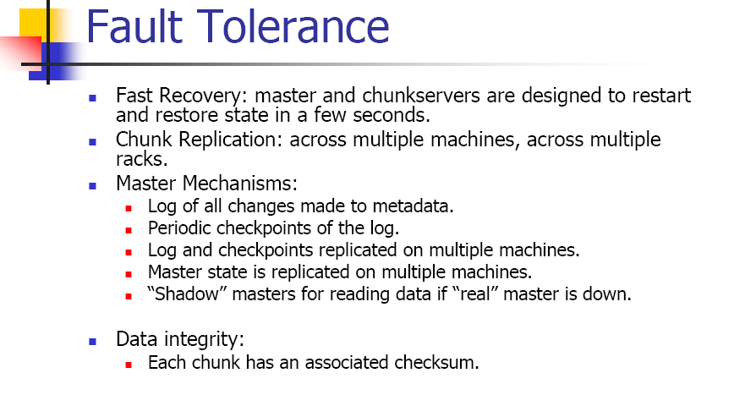

Slide 23
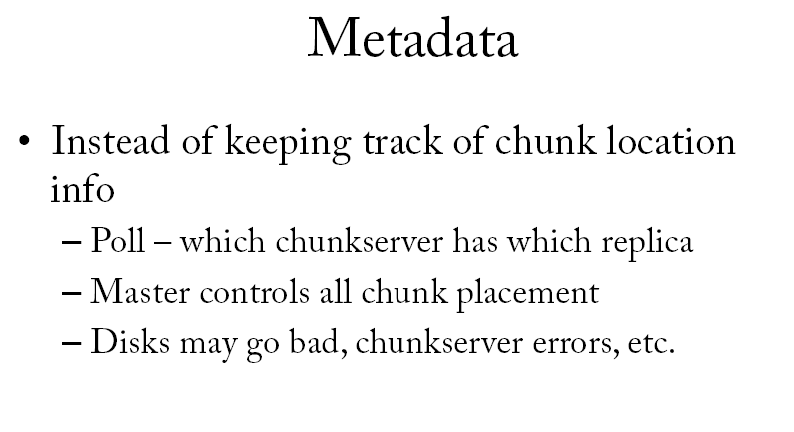

Slide 24
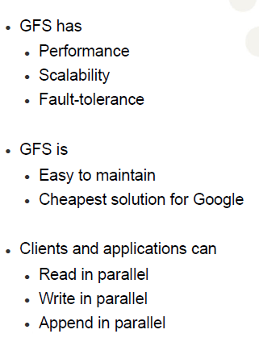
Conclusions

Slide 25


Slide 26
References
-
-
-

